Slide 1

Devops Organization in the Making
Vineet Banga
Sr. Software Development Manager, GE Digital
Jacob Johnson
Director of Cloud Services & Operations, GE Digital

Slide 2
Agenda
What is GE doing in s/w?
Where did we start?
Lessons learnt along the way
What’s next?

Slide 3
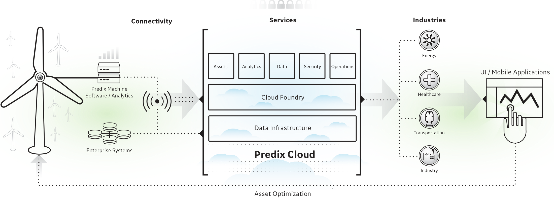
What is GE building?
Notes:
Predix platform – hosted PaaS offering, which connects industrial assets such as wind mills, jet engines etc. to the cloud.
The goal is provide a platform which streamlines development & deployment of applications in the industrial IOT space.
So in this picture we spend most of our time on the box in the middle and in that box I spend most of my time on building and managing Predix services.

Slide 4
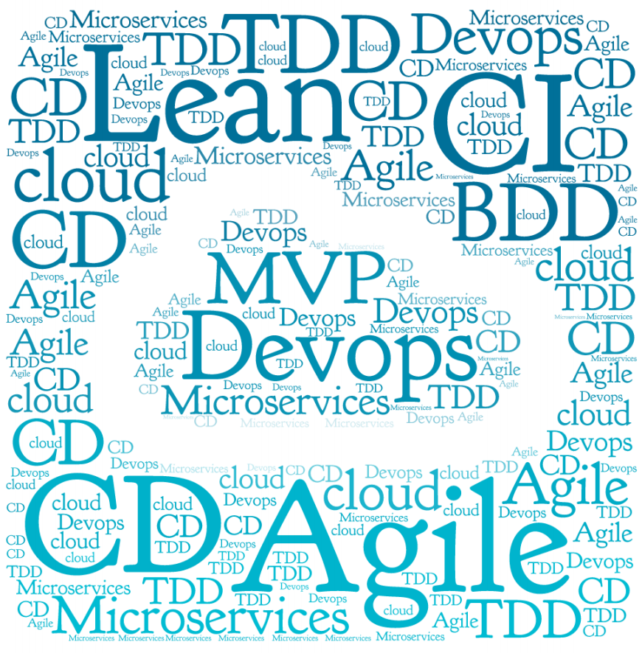
Where did we start?
What could go wrong?
Notes:
Following latest methodologies
Example project of notification service.

Slide 5
Is DevOps = Dev + Ops?
Notes:
Is devops, just about putting dev & ops together. I think we will all agree that, that’s not the goal – the goal in my view is to clear the path for the code to move from dev machine to production in an fast/reliable/agile/deterministic fashion.
So devops has to be more than sum of its part – putting dev and ops together in a team helped but it can we do better. At GE we believe, that a platform helps you make that jump – a platform which lets developer control how the service is built and deployed and at the same time allows operations to focus on mantaining and enhancing the platform.

Slide 6
Lesson #1
Its Devops only if its more than dev +ops
Platform accelerates devops practices
Platform provides the abstractions which allows dev & ops focus on what they are good at
Unified pipeline for the app

Slide 7
Overlooked aspect of Devops?
Notes:
So this is one area, which we are currently working on and its our goal to improve on this aspect of devops, and I have categorized it as an overlooked aspect especially at the application level. Given that dev teams now own the deployment pipelines, this is something that they tend to overlook – monitoring of applications.

Slide 8
Lesson #2
Continuous Monitoring has to follow CI/CD
Monitoring has to be a part of each deployment
You need monitoring to evolve your application/service
Can’t be just an Ops function

Slide 9
DevOps and Platform
Notes:
Follow ideology only goes so far

Slide 10
Let’s talk more about the platform (PaaS)
Abstract the programmable infrastructure
Rapid Elasticity
CI/CD tools as a service
Monitoring tools as a service
Dev’s own the application all the way to deployment
Operations support the platform and focus on enhancing the services in the platform
Notes:
We organized Predix around Cloud Foundry, which gives us a lot of things… arguably the most important is that it abstracts away the infrastructure from the software engineers. Application teams no longer need to come to operations with an order list
For starters we’ve abstracted

Slide 11
Lesson #3
Platform is Key
Well defined interface between apps and platform enable teams to work independently
Standardization around platform reduces operational effort
Automated Snowflakes are still Snowflakes

Slide 12
Org Changes?
Notes:
Follow ideology only goes so far

Slide 13
Lesson #4
Changing org structure does not change the beliefs
Platform makes the need for org changes irrelevant
Push as many decisions to the team as possible
Give the teams more control over the outcomes
Workstation proximity is more important than management hierarchy
Notes:
The evolution of good ideas

Slide 14
Who is in control?
Notes:
Once you have a team owning the service all the way – who is in control? Do dev’s have access to the production env? We faced this question quite a bit and at GE given the nature of our business, compliance and regulations are a big part of the equation. Now that development team can fully own the pipleline all the way to production – thanks to the platform, do they access to the production. Well they don’t – the machines are the only one’s with access – we use jenkins and the job parameterized and they can target the production env. Dev team relies on jenkins for deployment and monitoring tools to troubleshoot but they don’t have access to development environment.
So again this is just a way of thinking, the team that owns the service should own the deployment but they don’t need access to production environments – that is the job of CI/CD tools – so we let the machines have the control and the access.

Slide 15
Lesson #5
Machines are in control
Teams build the code, test the code, build the pipelines
The pipelines are in control of deployment
What about segregation of duties?
Approval steps
Incident Management can get interesting, but you can do it

Slide 16
Top Takeaways
A Platform can accelerate your devops journey
Continuous Monitoring
Give teams control over the outcomes
Co-locate Teams (Devs+Ops)

Slide 17
Challenges
CI / CD Tools – need better integration with platforms
Need more devs who can think like ops
Need more ops who can think like devs
Platform maturity
Building security & compliance in pipelines

Slide 18
Demo
Notes:
Give a demo of ease of operations on a Paas – may be green/blue deployment – Need to check the timing also.

Slide 20
Q&A

